Slide 1

Project: Personalize or Perish
Team Name: CTRL ALT DEL
Team Members:
Shubham Darji
Titiksha Bhavsar
Rohit Gupta
Vivek Masuna
Aryan Yadav

Slide 2
Problem Statement and Assumptions
Tata STRIVE needs an intelligent support system to shift from a reactive "catch-up" model to a proactive "keep-up" model. Facilitators currently identify struggling students too late and spend excessive time creating remedial content, limiting personalized learning and mentorship.
We are seeking a solution that can: Assumptions:
Automatic
content
generation
Diagnose
Learning gaps
Learners and facilitators have reliable digital access.
Curriculum and student performance data are digitized.
Facilitators will act on AI-generated insights.
Student assessment scores are assumed accurate.
Personalized support materials
Student’s learning journey

Slide 3
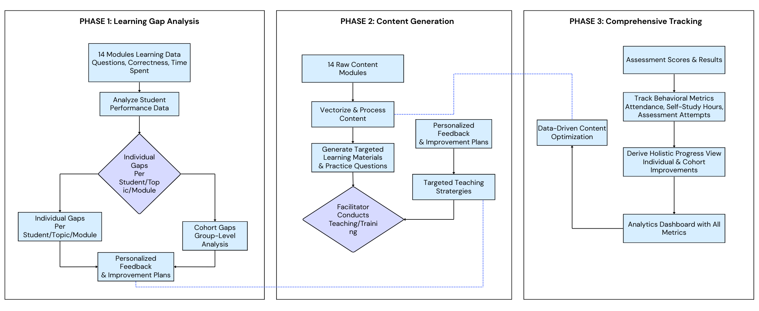
Proposed Solution

Slide 4
Proposed Solution
Phase 1
Collect results from the 14 modules (questions attempted, selected, correctness, time spent, etc.) as input/output.
Analyze results to produce:
Individual learning gaps (per student, question/module/topic-wise).
Cohort learning gaps (for the group).
Use analysis output for feedback and improvement.
Phase 2
Begin with content (14 modules) as input.
Process content (vectorize).
Generate relevant learning materials and practice questions as output.
Facilitator uses these materials for teaching/training.
Phase 3
Use assessment scores as input/output.
Derive a holistic view of individual and cohort improvements.
Track and record attendance, self-study hours, and number of assessment attempts.
Display all these metrics in a dashboard.

Slide 5
Future Roadmap
Nationwide Expansion
Scale the system across all Tata STRIVE centres, standardising high-quality vocational education.
Advanced Multilingualism
Integrate comprehensive multi-language support, including regional dialects, for broader accessibility
AI-Driven Adaptive Learning
Implement AI-driven adaptive learning paths, tailoring content and pace to individual student needs.
LMS & Attendance Integration
Seamlessly integrate with existing LMS and attendance systems for unified data and streamlined operations.
Predictive Analytics
Develop predictive analytics capabilities for proactive interventions, identifying and supporting at-risk students early.

Slide 6
Conclusion - Key Takeaways & Impact
Key Takeaways
Shifted the model from reactive "catch-up" to proactive "keep-up" learning.
Designed an AI-powered system to diagnose gaps, generate targeted materials, and track progress.
Built a facilitator dashboard for real-time insights and easy intervention.
Impact
For Students (Youth): An academic safety net that provides personalized support when it’s needed most, boosting confidence, mastery, and placement outcomes.
For Facilitators: Acts as a superpower—automating content generation and diagnostics, freeing time for high-impact one-to-one coaching.
For Tata STRIVE: Enhances operational efficiency, reduces dropout rates, and enables a scalable, data-backed skilling model across India.

Slide 7
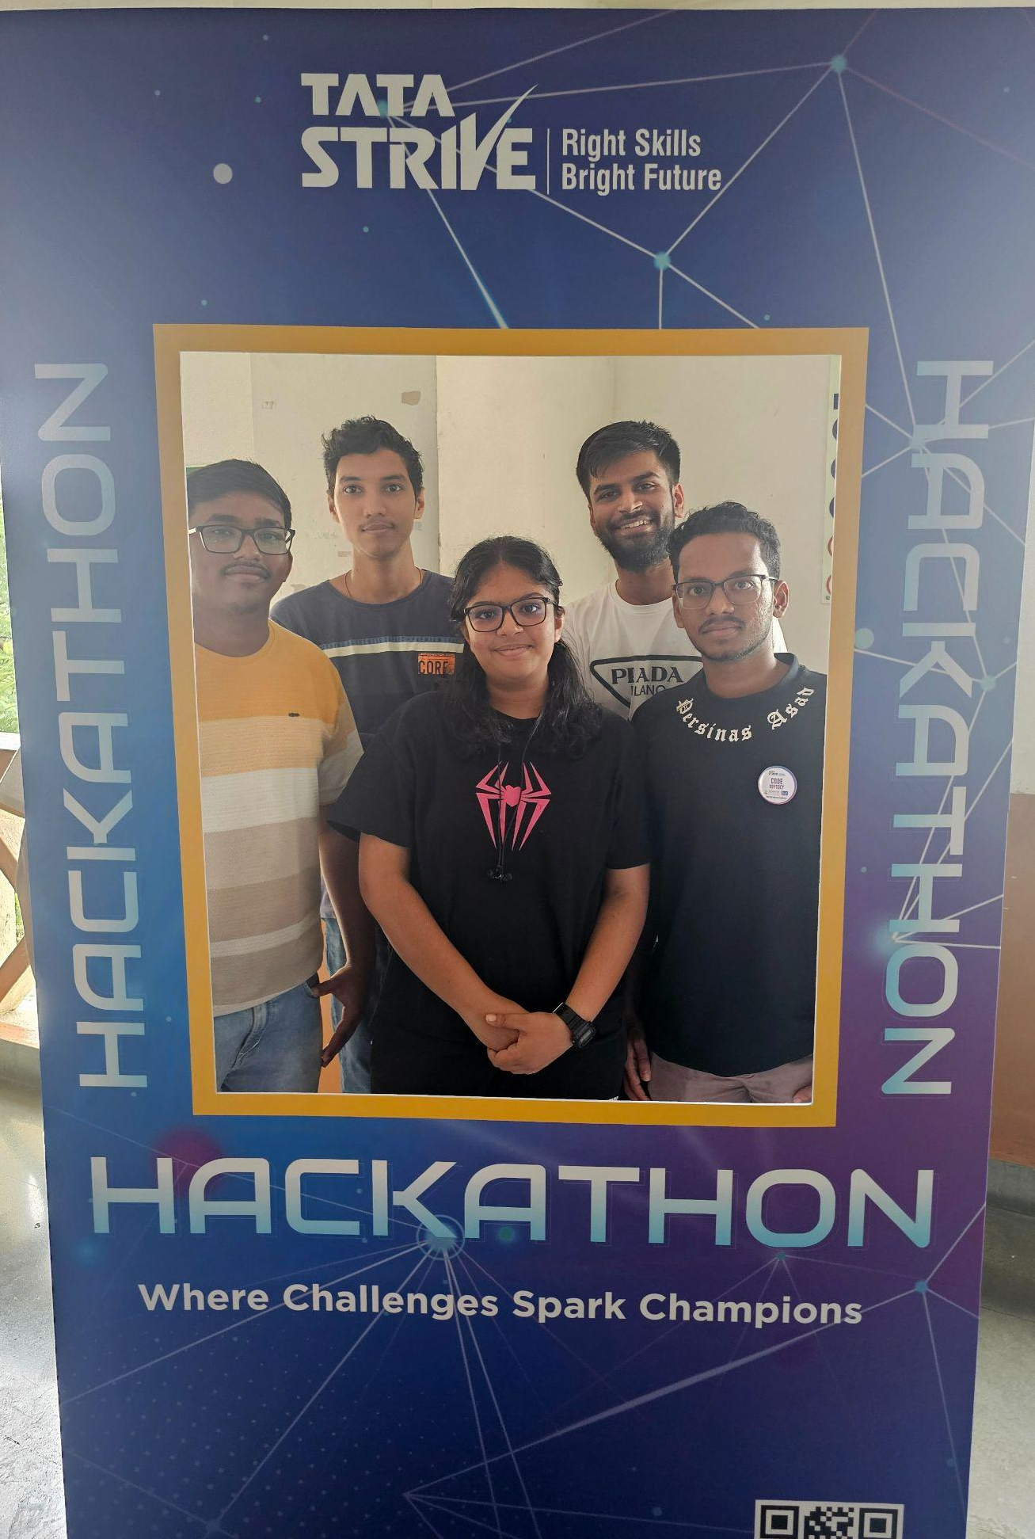
Thank You

Slide 8

Implementation Video

